Slide 1
EGI Notebooks, DataHub and Binder
PaNOSC Annual Meeting
Trieste, Nov. 04-05, 2019
Giuseppe La Rocca
EGI Foundation

Slide 2
EGI Notebooks: Service architecture
https://notebooks.egi.eu/
The EGI Notebooks service relies on the following technologies to provide its functionality:
JupyterHub with custom EGI Check-in oauthentication configured to spawn pods on Kubernetes.
Kubernetes as container orchestration platform running on top of EGI Cloud resources.
CA authority to allocate recognised certificates for the HTTPS server.
Specific EGI hooks for monitoring and accounting.

Slide 3
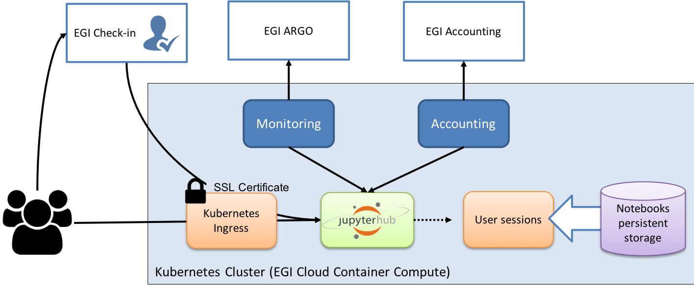
EGI Notebooks: The high-level service architecture

Slide 4

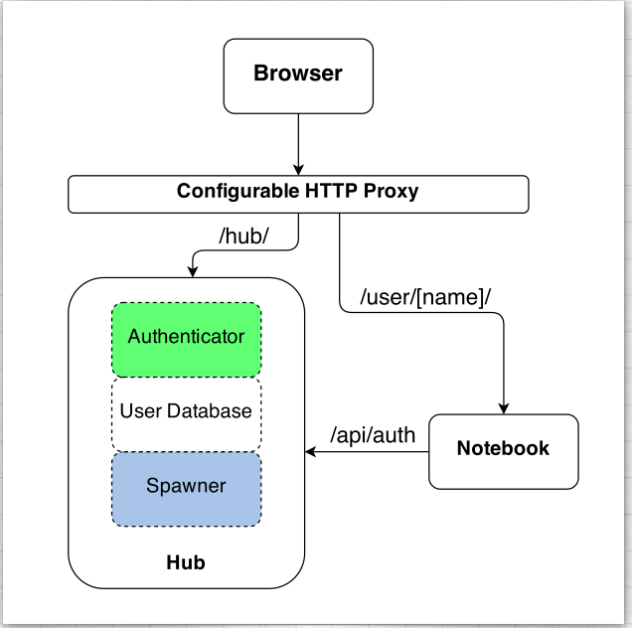
JuputerHub: how it works
https://jupyter.org/hub
Jupyter is single user by design
JupyterHub is a multi-user version of notebook designed for companies, classrooms and research labs
Manages Authentication
Spawns single-users notebooks servers on-demand
Gives each user a complete Jupyter server

Slide 5
Authenticator
https://jupyter.org/hub
Deals with Authentication
Default is PAM, but lots of them available:
OAuth2.0 (OpenID Connect can be included here)
LDAP
Kerberos
REMOTE_USER
JSON Web token
Shibboleth
…
Documentation: https://jupyterhub.readthedocs.io/en/latest/reference/authenticators.html

Slide 6
Spawner
https://jupyter.org/hub
Spawns notebooks:
Start and Stop the process
Poll whether the process is still running
Some examples:
BatchSpawner
DockerSpawner
KubeSpawner
SudoSpawner
WrapSpawner
Documentation: https://jupyterhub.readthedocs.io/en/latest/reference/spawners.html

Slide 7

Kubernetes
https://kubernetes.io/
Kubernetes is an open-source container-orchestration system for automating application deployment, scaling, and management.
It groups containers that make up an application into logical units for easy management and discovery.
Schedule containers to physical or virtual machines
Restart containers if they stop
Provide private container network
Scale up and down
Service discovery

Slide 8

Helm
https://helm.sh/
Helm is a package manager for Kubernetes
Allows to easily install applications/services easily
Wide catalogue of charts with some defaults (see next slide)
A chart is a collection of files organized in a specific directory structure

Slide 9
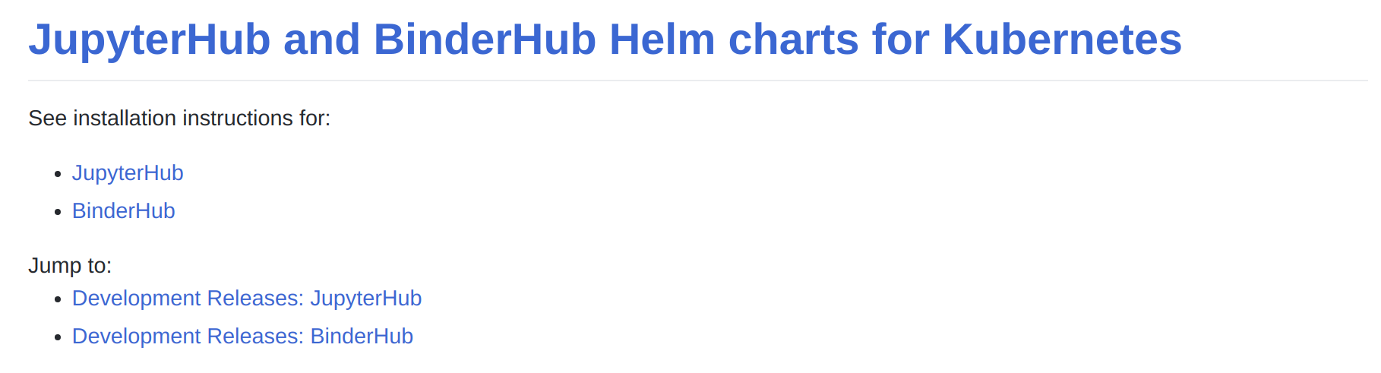
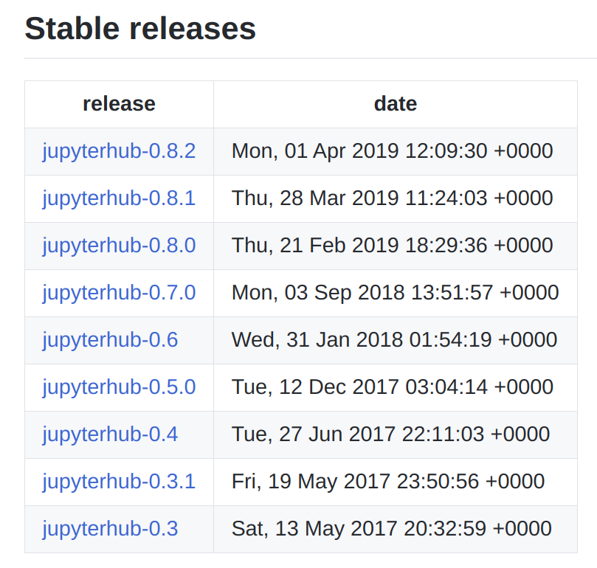
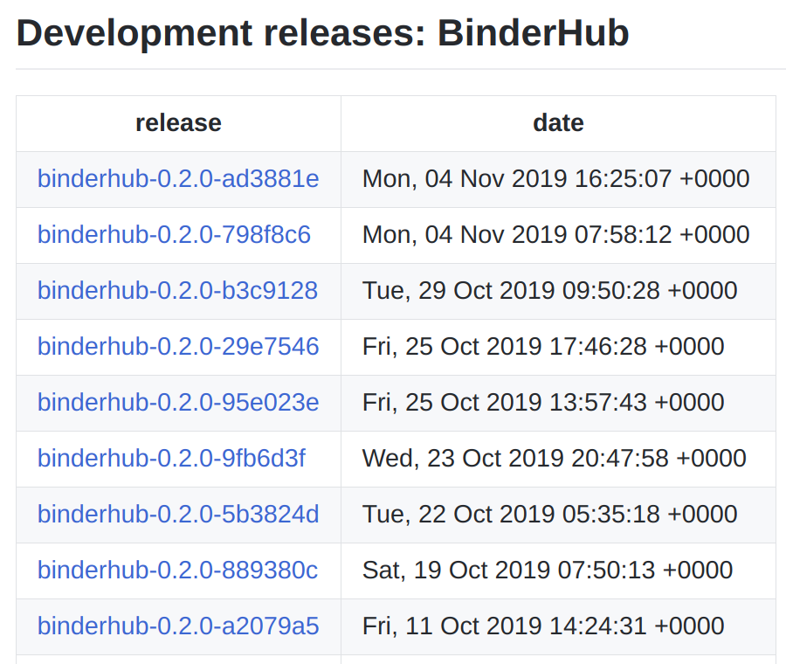
More Helm charts
https://jupyterhub.github.io/helm-chart/

Slide 10

JupyterHub Helm customisation
JupyterHub helm chart is highly adaptable to your needs
What image the users should run
What storage should the users have associated with
What kind of authentication should be used
EGI Notebooks is mostly customisation of the JupyterHub helm
Using our notebooks images
With EGI Check-in Authentication
NFS Persistent Volumes
And some extra pods deployed for monitoring and accounting

Slide 11
Setting up the JupyterHub
# Initialize the helm
]$ helm init
# Add the jupyterhub helm repo
]$ helm repo add jupyterhub https://jupyterhub.github.io/helm-chart/
]$ helm repo update
# Prepare the configuration file
]$ cat notebook.yaml proxy:
secretToken: "<RANDOM_HEX>"
IP: XXX.XXX.XXX.XX
# Install the jupyterhub helm repo
]$ helm install jupyterhub/jupyterhub --version=0.8.2 \
--name=$HELM_RELEASE_NAME --namespace=jupyterhub -f notebooks.yaml

Slide 12
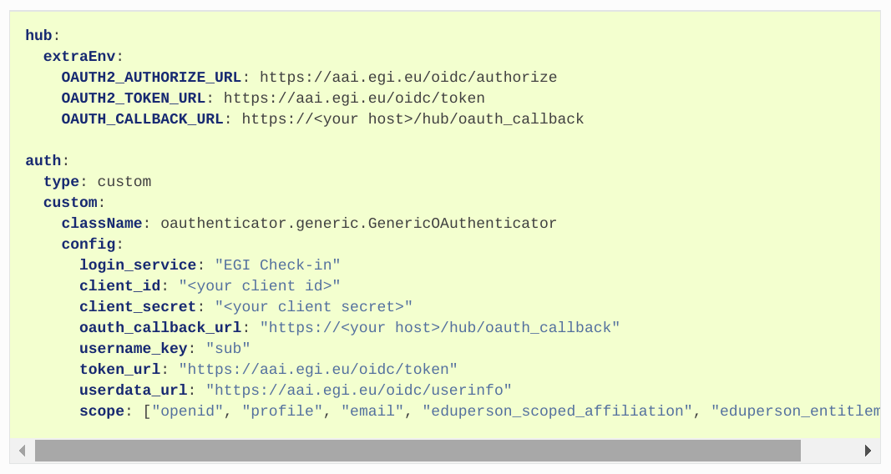
Helm chart to use EGI AAI Check-In

Slide 13
Upgrade the JupyterHub
# Upgrade the jupyterhub helm repo
]$ helm upgrade jupyterhub/jupyterhub --version=0.8.2 \
--name=$HELM_RELEASE_NAME --namespace=jupyterhub -f egi_aai_check-in.yaml
# Explore what's there
]$ kubectl get pod -n juyterhub

Slide 14
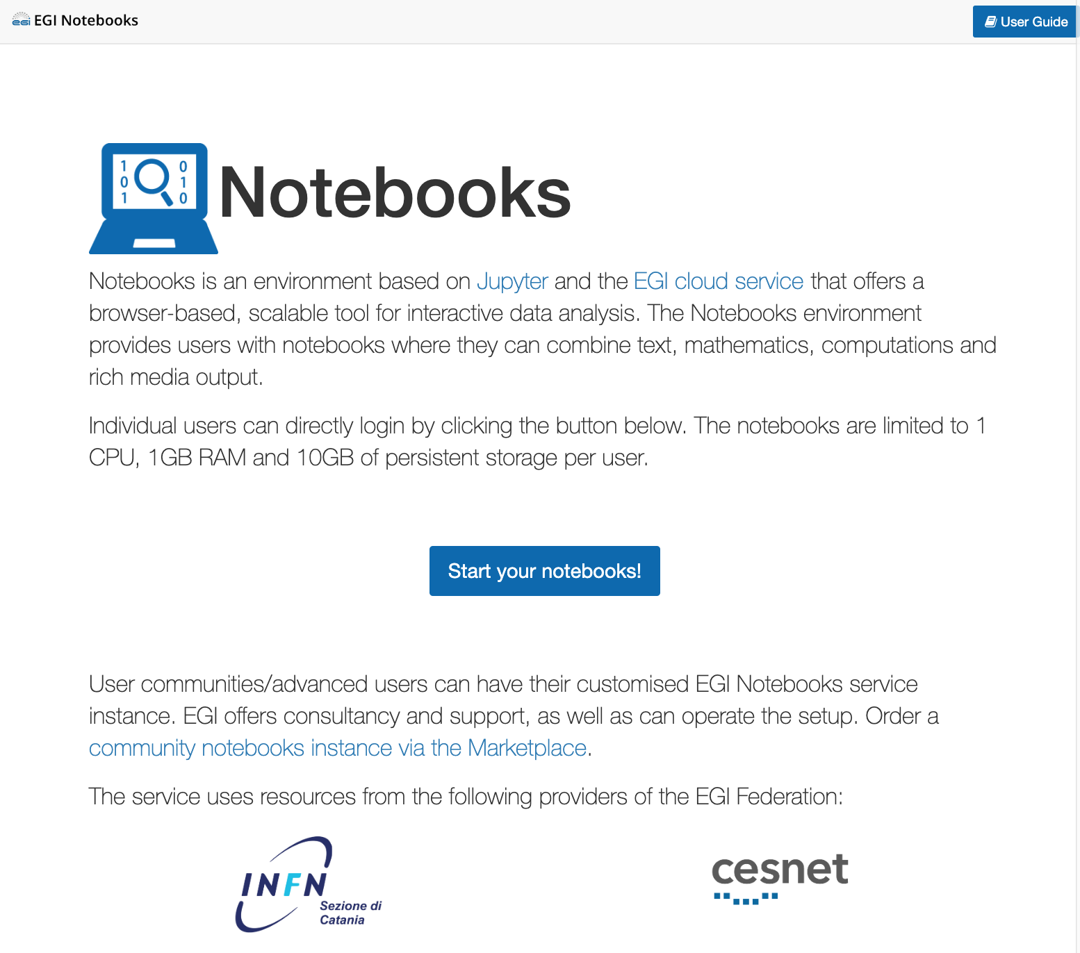
EGI Notebooks
User guide
https://notebooks.egi.eu
Start from JupyterHub
Multi-user server to spawn single-users' notebooks
Support community libraries and kernels
Host on the EGI Clouds Scalable computing
Allocate CPUs from a single site
Setup Notebooks on multiple sites (or in cloud with bigger VMs)
Connect with DataHub Scalable data access
Distributed file system for I/O
Present datasets as local directories in Jupyter
Assign DOIs (Alpha)
DOI for the Notebook
DOI for the data used by the Notebook
Setup Binder (Alpha)
One-click replay of a Notebooks and data
Login
Reproducibility

Slide 15
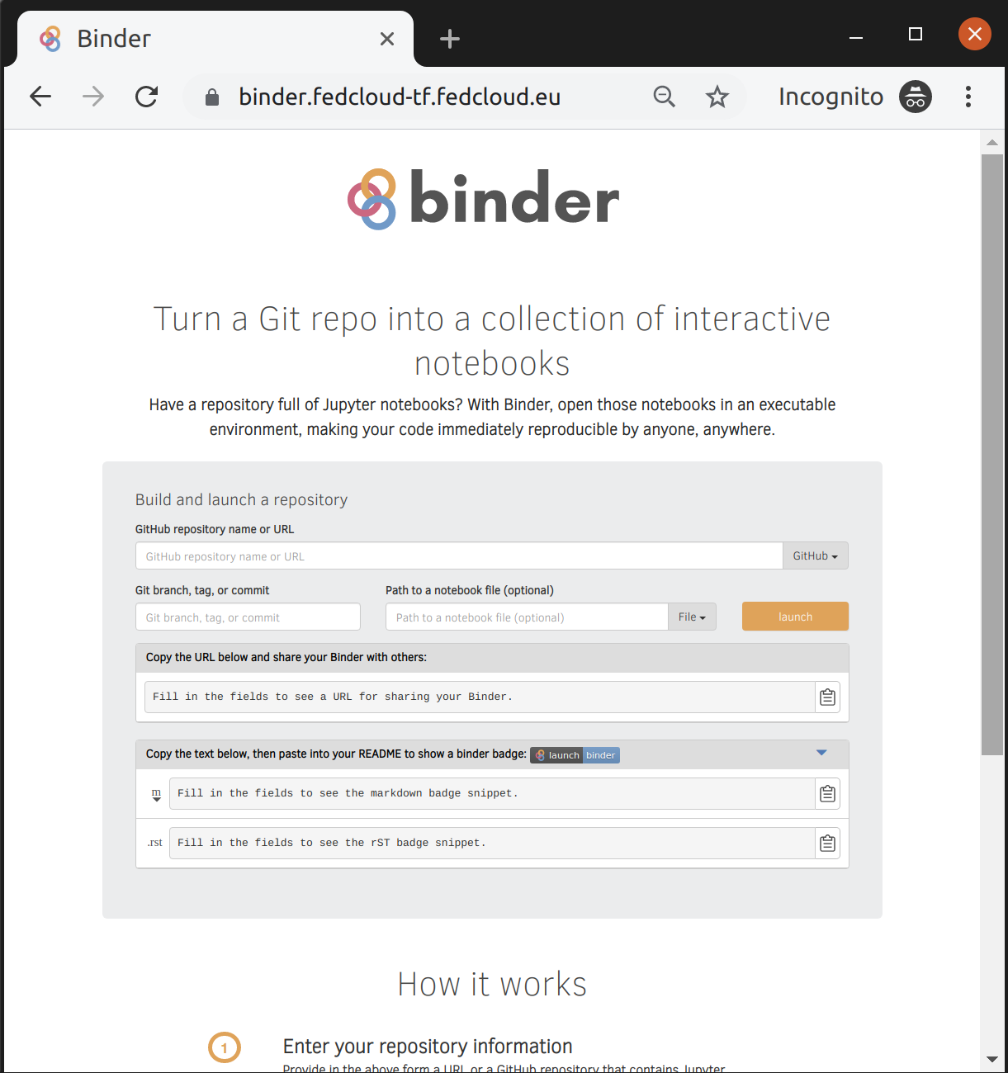
EGI Binder service
https://binder.fedcloud-tf.fedcloud.eu
The service is available in Alpha mode for restricted users
Notebooks to reply in the service are limited to 1 CPU, 1GB RAM and 10GB of persistent storage per user
Production version is planned to be opened in late 2019

Slide 16
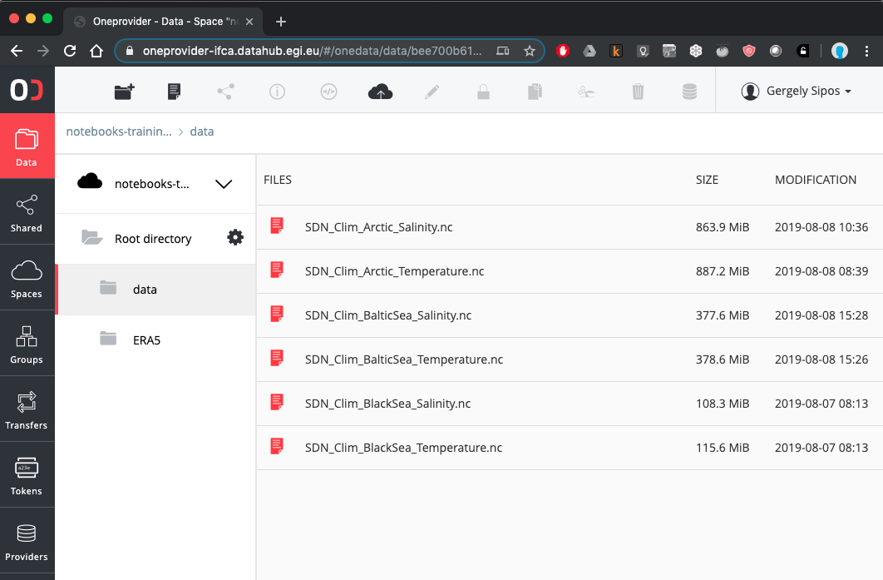




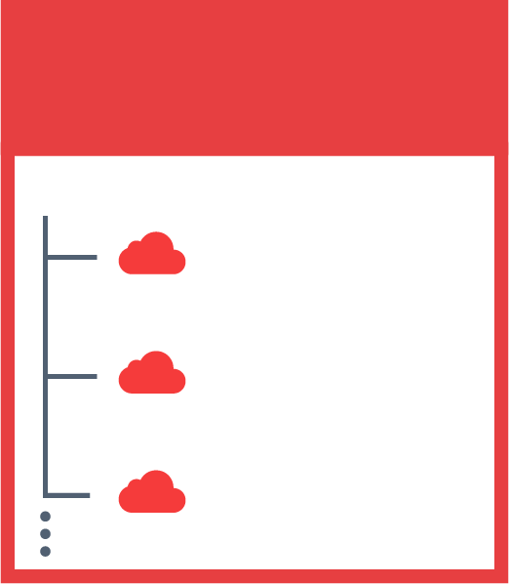

EGI DataHub - https://datahub.egi.eu
Virtual, global file systems
A provider: Physical storage for files
JOHN’S SPACES
SENTINEL 2
DEEP LEARNING
SARA’S SPACES
PUBLICATIONS
A space: Hierarchical organisation of files. (Directory structure)
SENTINEL 2
SKY MAPS
MY DATA

Slide 17
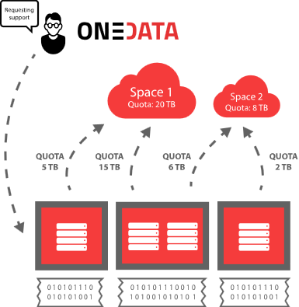
Components
Spaces:
A virtual volume where users organize their data
Spaces can be shared with other users and even exposed to the public
Each space has to be supported by one or multiple Oneprovider

Slide 18
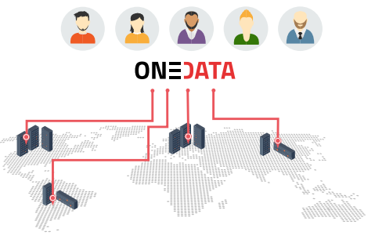
Components (cont.)
Oneprovider:
Data management component deployed in the data centres, provisioning data and managing transfers.
Any centre can become a provider by installing Oneprovider service, attaching some resources and registering it in Onezone

Slide 19
Components (cont.)
OneZone:
Onezone is responsible for authentication and authorization of users
Any organization, community or users group can deploy their own Onezone service
It allows providers from different zones to interact with each others and share data
Oneclient:
A client providing access to the space through a FUSE mount point (local POSIX access)
Web interface and REST APIs are also available

Slide 20
JupyterHub integration
fs-opendatafs - Direct access to Onedata Virtual filesystem from Python
No need to create Fuse mount point on local machine
Possible to access Onedata from Docker without the “--privileged” option
No need for mapping UID and GID between user applications and Oneclient
Possibly better performance without Fuse bottleneck
Installation using pip
Support both for Python 2 and Python 3
Available as PyFilesystem plugin

Slide 21

PyFileSystem
PyFilesystem is a Python library providing abstraction over various types of file systems
Supported file systems:
FTP,
SSH,
Zip,
Tar,
S3,
WebDAV,
Dropbox,
GoogleDrive, ... ,
and now Onedata
Notes:
PyFilesystem provides a simplified common interface to a variety of different filesystems, such as the local filesystem, zip files, ftp servers etc.

Slide 22
Installation
Ubuntu:
# For Python3
wget wget http://packages.onedata.org/oneclient-1902.sh
sh oneclient-1902.sh python3-fs-plugin-onedatafs
apt install python3-pip
pip3 install fs

Slide 23
Usage
Basic usage using standard PyFilesystem API
from fs_onedatafs import OnedataFS
onedata_onezone_host = “...”
onedata_access_token = “...”
odfs = OnedataFS(onedata_onezone_host, onedata_access_token, force_proxy_io=True)
odfs.listdir(‘/’)
print(odfs.getinfo(‘/file.txt’).permissions)
with odfs.openbin(‘/file.txt’, ‘r’) as f:
print(f.read())

Slide 24






The SeaDataNet’s use scenario
https://github.com/EGI-Foundation/training-notebooks-seadatanet/blob/master/seadatanet.ipynb
EGI Notebooks
DataHub
EGI Binder
1. Setup and perform data analysis and visualisation; Download notebook
Data PID minting
GitHub
6. Reproduce big data analysis
Your repository
2. Publish notebook and Generate DOI
5. Resolve DOI to Notebook and Data
Fellow researchers
3. Cite DOI
(e.g. in publication)
Journal paper
4. Discover DOI

Slide 25
References
Jupyterhub:
https://jupyterhub.readthedocs.io/en/stable/
Kubernetes:
https://kubernetes.io/
Helm:
https://www.helm.sh/
Zero to Jupyterhub:
https://zero-to-jupyterhub.readthedocs.io/en/latest/index.html
EGI helm charts:
https://egi-foundation.github.io/egi-notebooks-chart/
EGI Notebooks:
https://notebooks.egi.eu
EGI Notebooks on GitHub:
https://github.com/EGI-Foundation/notebooks

Slide 26
Thank you!

